Slide 1
CSCE 421: Machine Learning
Lecture 22: Neural Networks
Texas A&M University

Slide 2
Outline
Perceptron
Approximating linear functions
Activation Function
Backpropagation
Optimization
Neural Network Training and Design

Slide 3
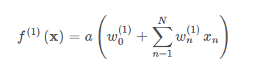
Neural networks: Original motivation
Inspiration from the brain
Brain is a powerful information processing device
Composed of a large number of processing units (neurons)
Neurons operating in parallel → large connectivity
Neural networks as a paradigm for parallel processing
Notes:
Lec 26 page 3

Slide 4
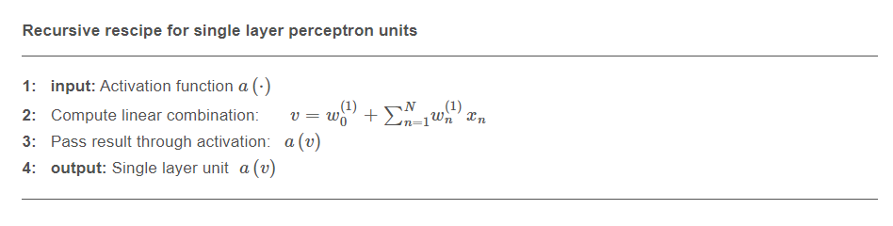
Single Layer NN

Slide 5
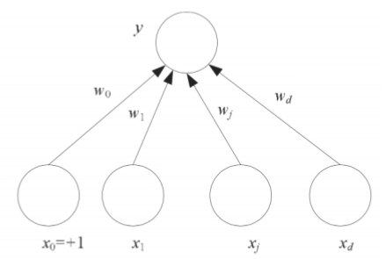
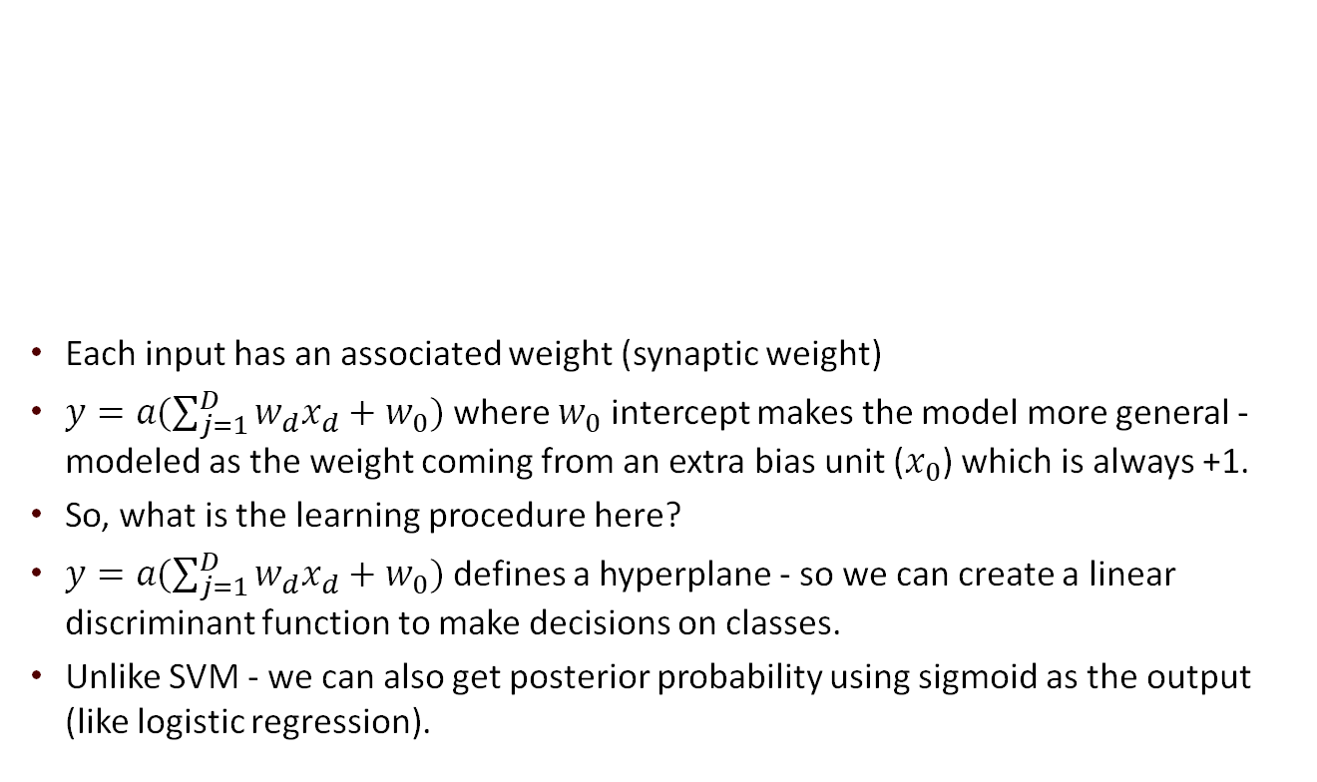
Perceptron
Each input has an associated weight (synaptic weight)
$y=a(\sum_{j=1}^{D}{w_{d}x_{d}+w_{0})}$ where $w_{0}$ intercept makes the model more general - modeled as the weight coming from an extra bias unit ($x_{0}$) which is always +1.
So, what is the learning procedure here?
$y=a(\sum_{j=1}^{D}{w_{d}x_{d}+w_{0})}$ defines a hyperplane - so we can create a linear discriminant function to make decisions on classes.
Unlike SVM - we can also get posterior probability using sigmoid as the output (like logistic regression).
Notes:
Lec 26 page 6

Slide 6
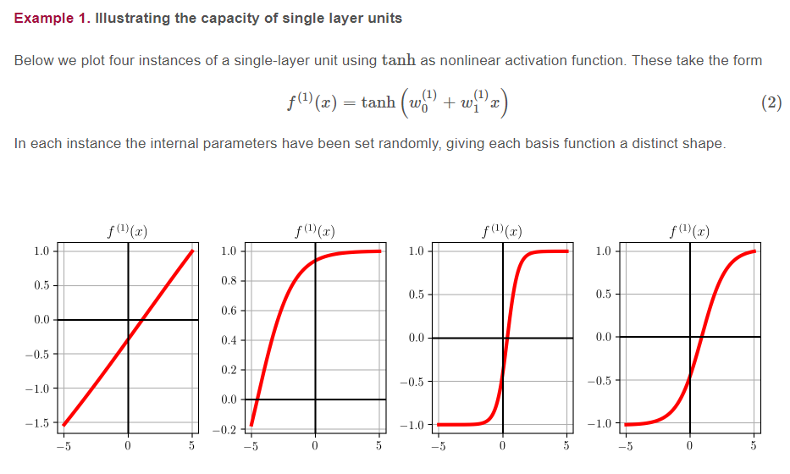
Activation Functions

Slide 7
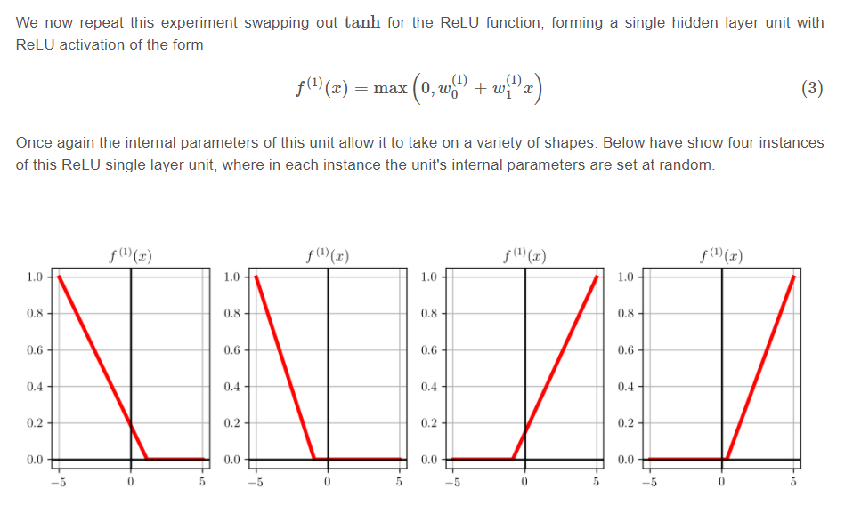
More Activation Functions

Slide 8
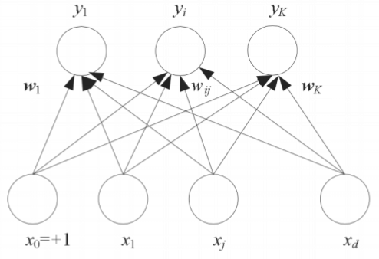
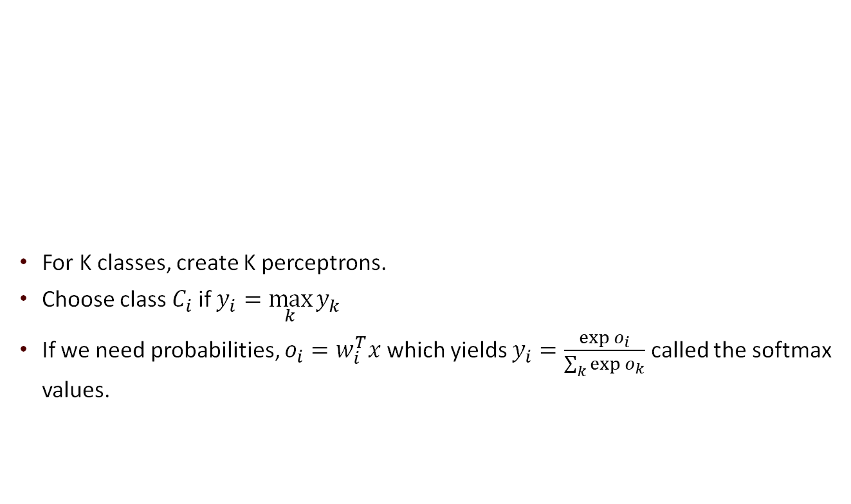
Perceptron: Multiple Classes
For K classes, create K perceptrons.
Choose class $C_{i}$ if $y_{i}=\max_{k}{y_{k}}$
If we need probabilities, $o_{i}=w_{i}^{T}x$which yields $y_{i}=\frac{\exp{o_{i}}}{\sum_{k}{\exp{o_{k}}}}$ called the softmax values.
Notes:
Lec 26 page 8

Slide 9
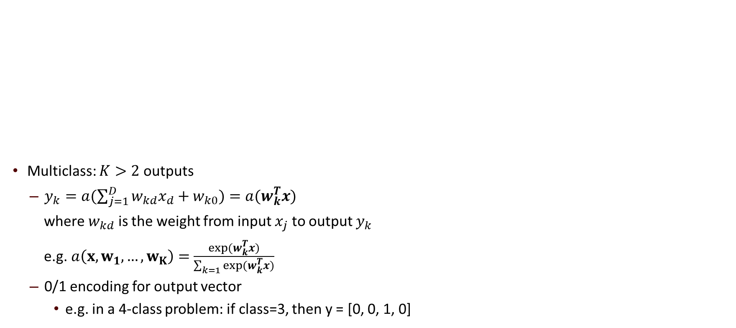
Perceptron: Multiple Classes
Multiclass: $K>2$ outputs
$y_{k}=a(\sum_{j=1}^{D}{w_{kd}x_{d}+w_{k0})}=a(w_{k}^{T}x)$
where $w_{kd}$ is the weight from input $x_{j}$ to output $y_{k}$
e.g. $a\left(x, w_{1}, …, w_{K}\right)=$ $\frac{\exp{(w_{k}^{T}x)}}{\sum_{k=1}{\exp{(w_{k}^{T}x)}}}$
0/1 encoding for output vector
e.g. in a 4-class problem: if class=3, then y = [0, 0, 1, 0]
Notes:
Lec 26 page 8

Slide 10
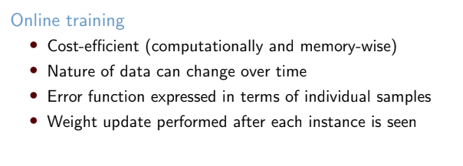
Perceptron: Training

Slide 11
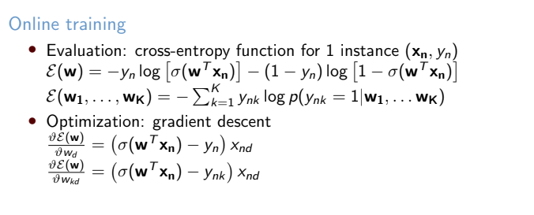
Perceptron: Training

Slide 12
Outline
Perceptron
Approximating linear functions
Activation Function
Backpropagation
Optimization
Neural Network Training and Design

Slide 13
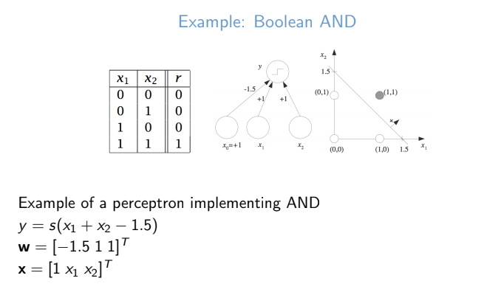
Approximating linear functions

Slide 14
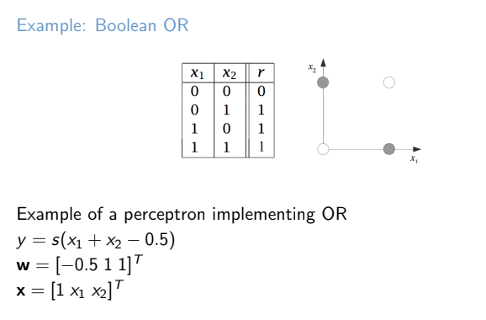
Approximating linear functions

Slide 15
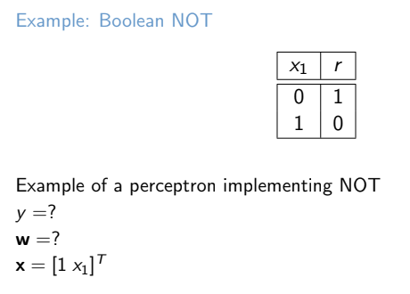
Approximating linear functions

Slide 16
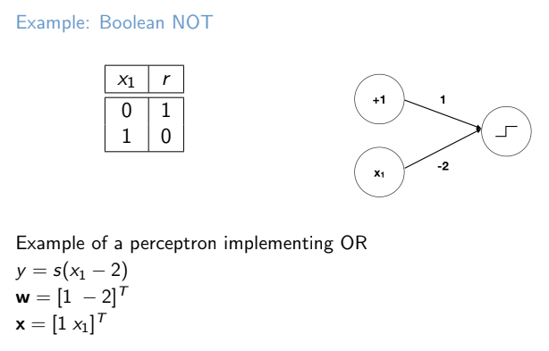
Approximating linear functions

Slide 17
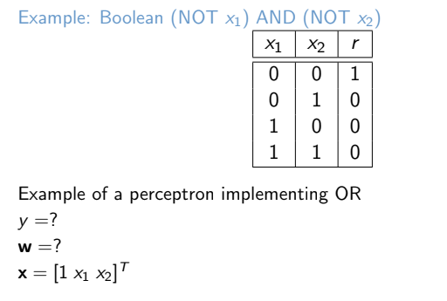
Approximating linear functions

Slide 18
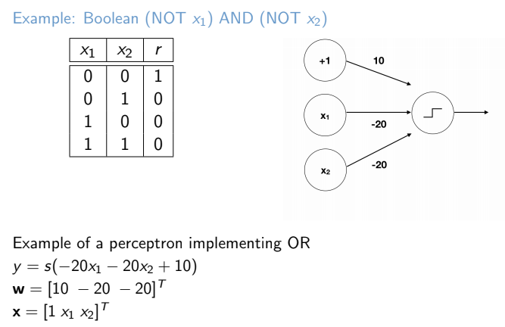
Approximating linear functions

Slide 19
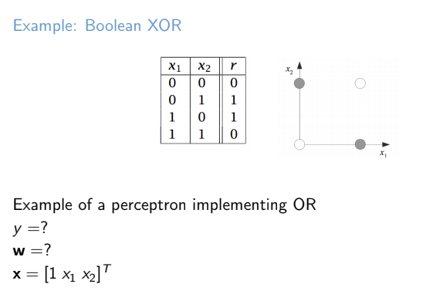
Approximating linear functions

Slide 20
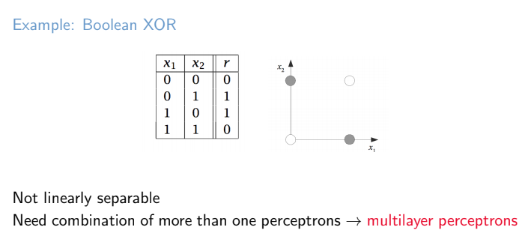
Approximating linear functions

Slide 21
Outline
Perceptron
Approximating linear functions
Activation Function
Backpropagation
Optimization
Neural Network Training and Design

Slide 22
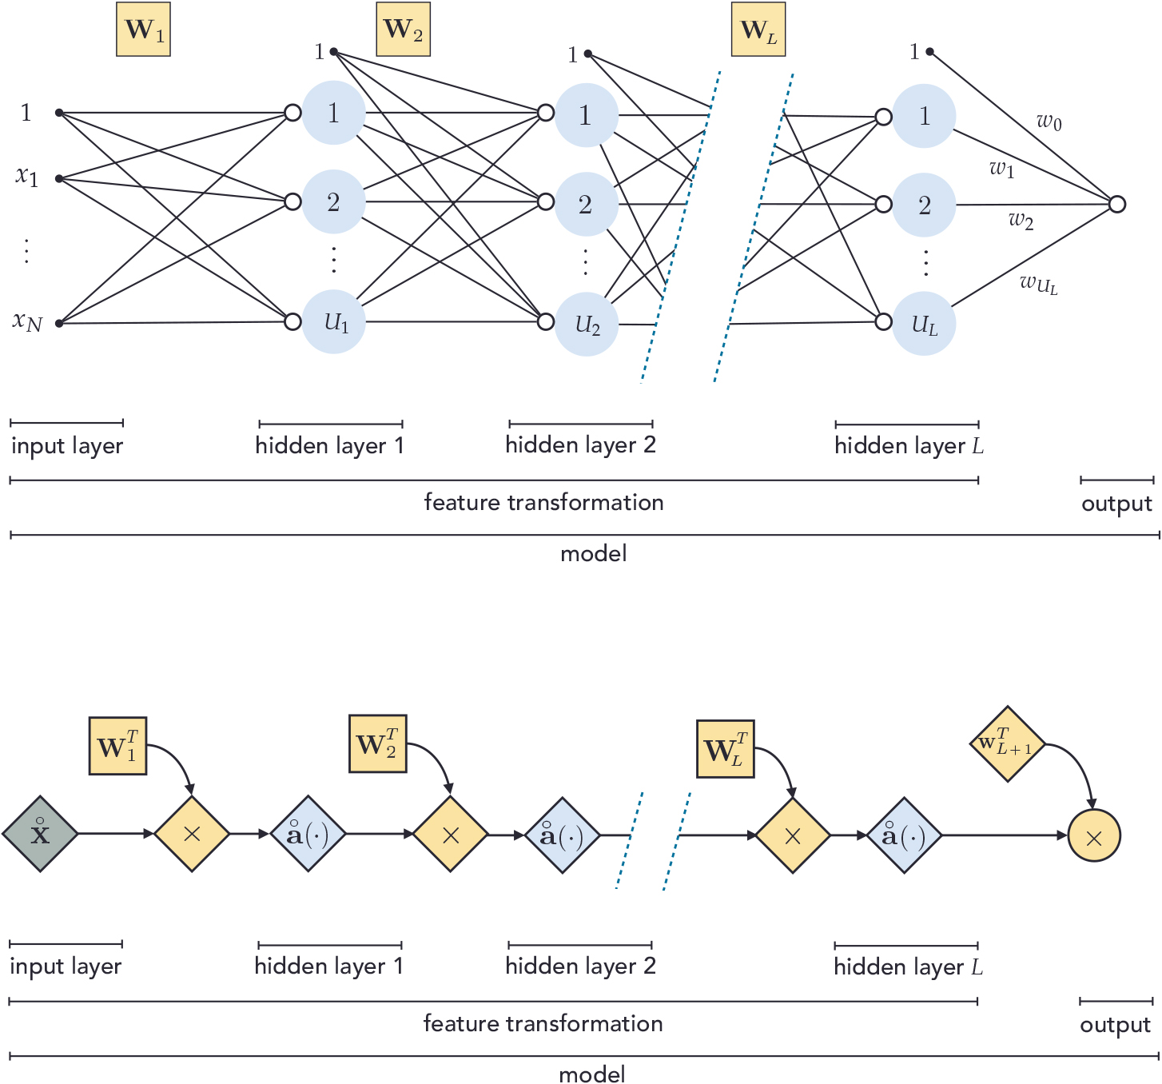
Can create complex functions with Deep Neural Networks

Slide 23
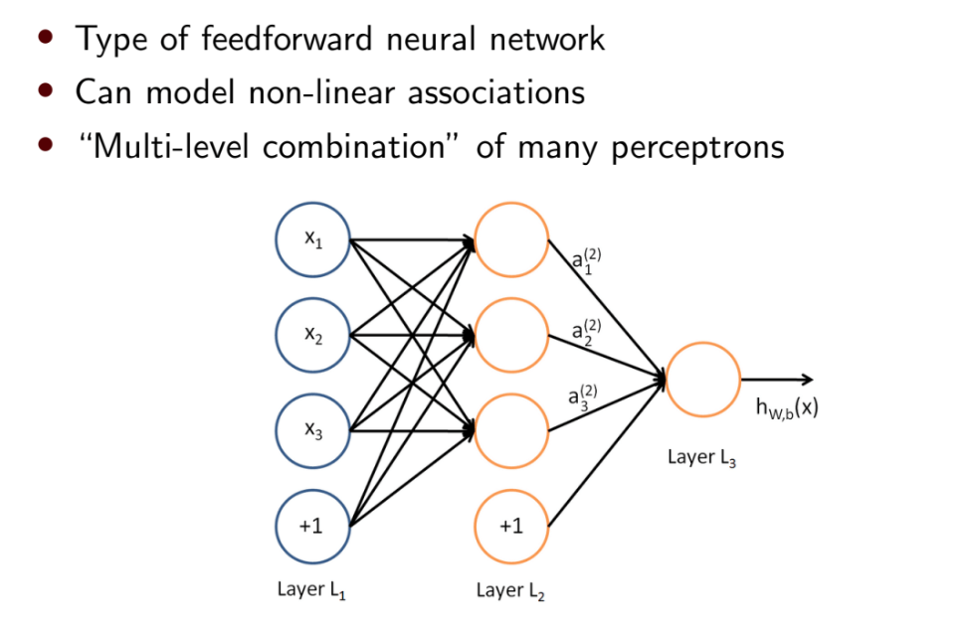
Multilayer Perceptron
Notes:
Lec 28 page 4

Slide 24
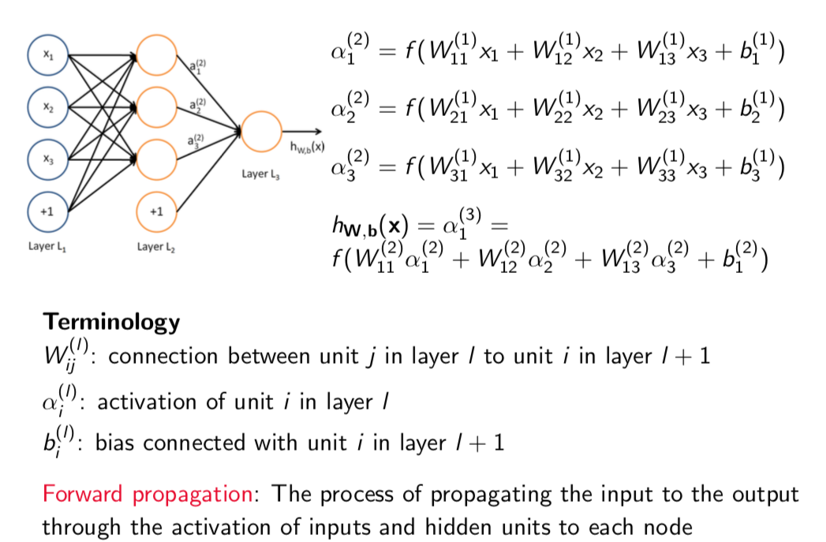
Multilayer Perceptron: Representation
Notes:
Lec 28 page 5

Slide 25
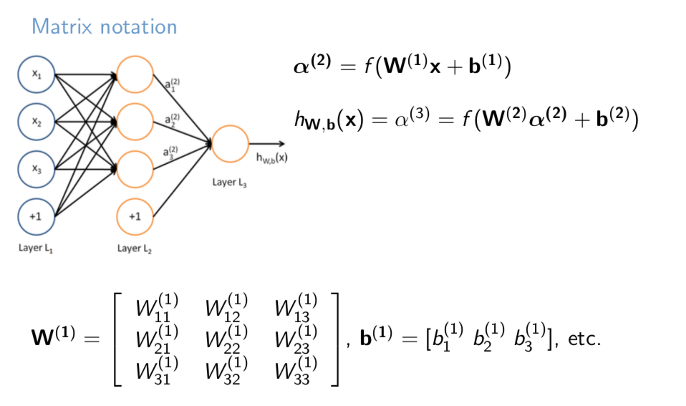
Multilayer Perceptron: Representation
Notes:
Lec 28 page 5

Slide 26
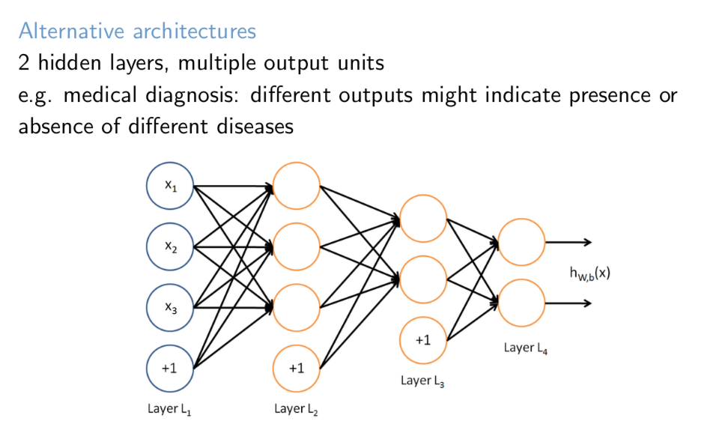
Multilayer Perceptron: Representation
Notes:
Lec 28 page 5

Slide 27
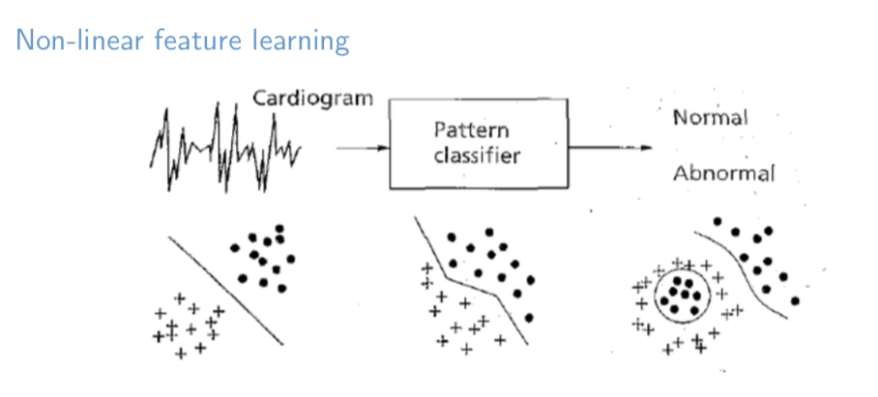
Multilayer Perceptron
Notes:
Lec 28 page 5

Slide 28
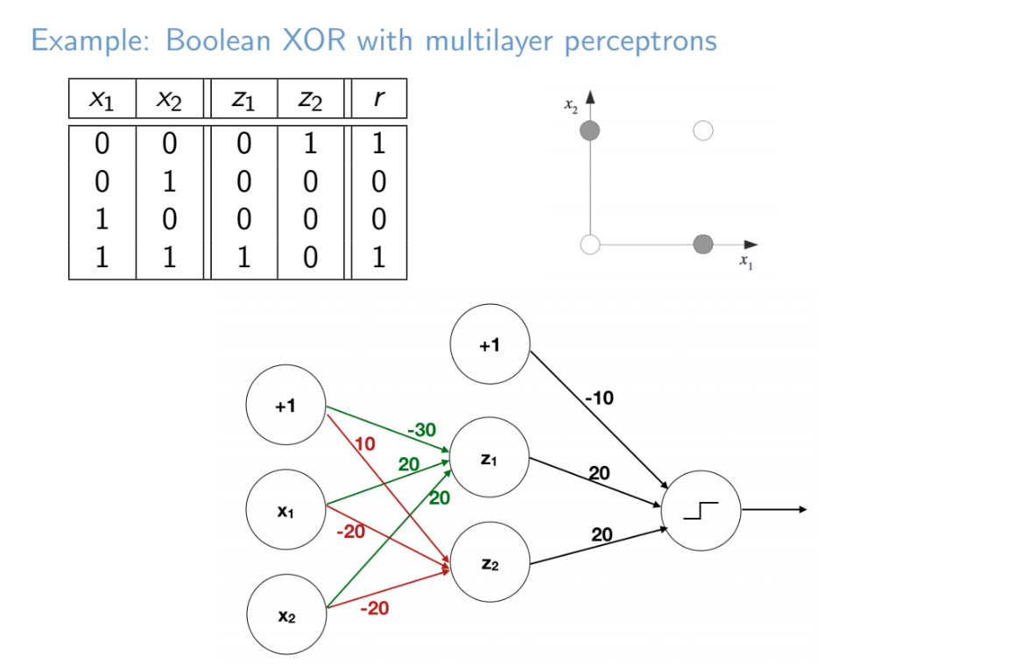
Multilayer Perceptron: Approximating non-linear functions
XNOR
Notes:
Lec 28 page 6

Slide 29
Outline
Perceptron
Approximating linear functions
Activation Function
Backpropagation
Optimization
Neural Network Training and Design

Slide 30
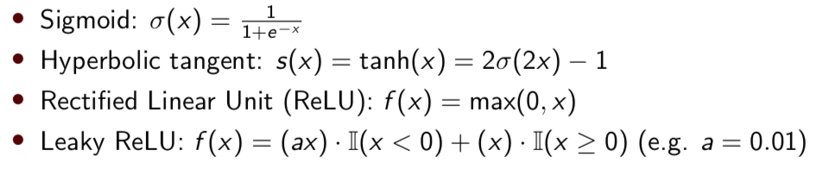
Activation Function
Activation function decides, whether a neuron should be activated or not by calculating weighted sum and further adding bias with it.
Purpose: introduce non-linearity into the output of a neuron.
Notes:
Lec 26 page 37

Slide 31
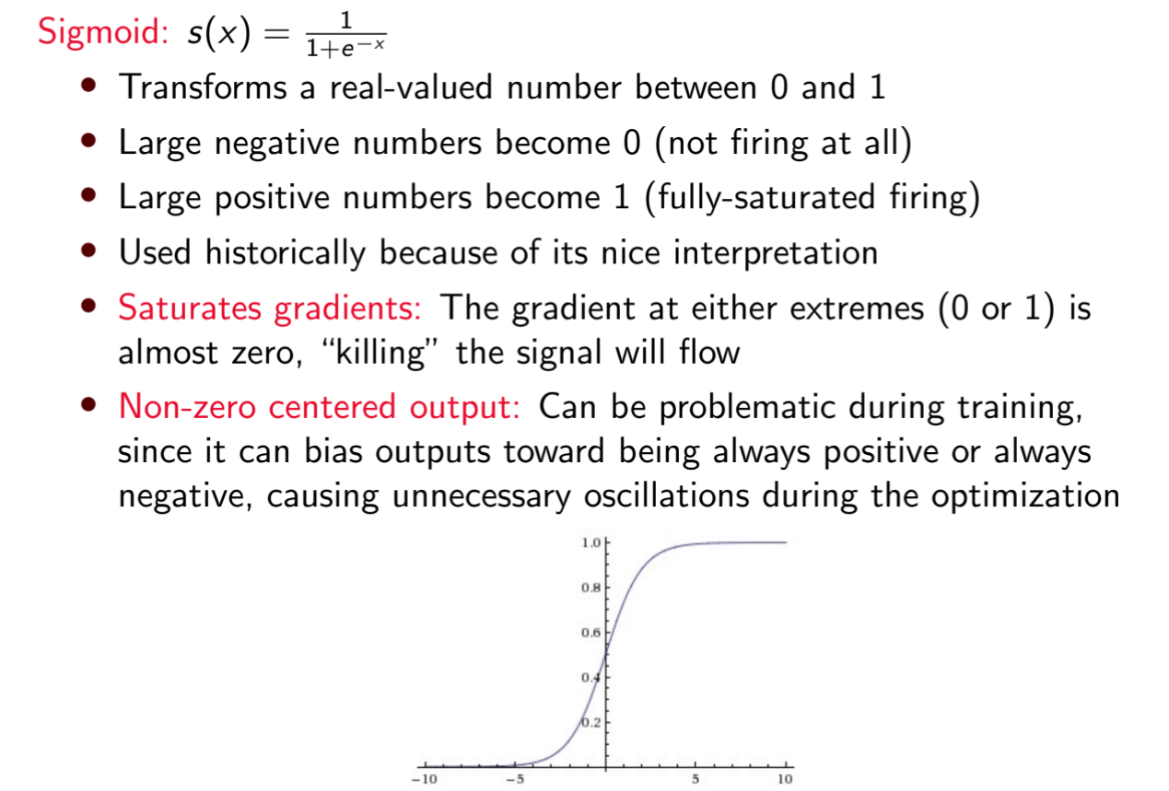
Activation Function
Notes:
Lec 26 page 38

Slide 32
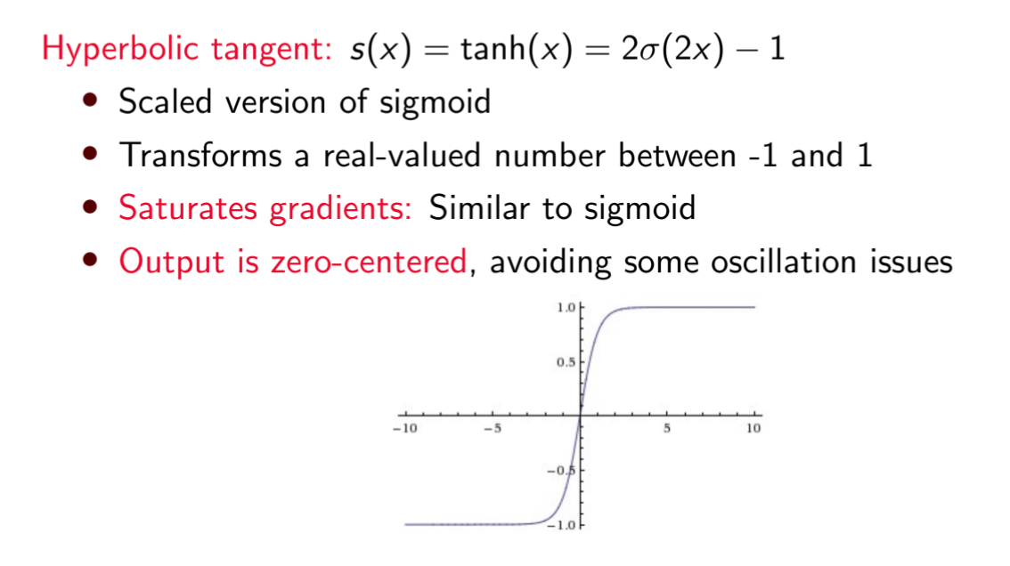
Activation Function
Notes:
Lec 26 page 39

Slide 33
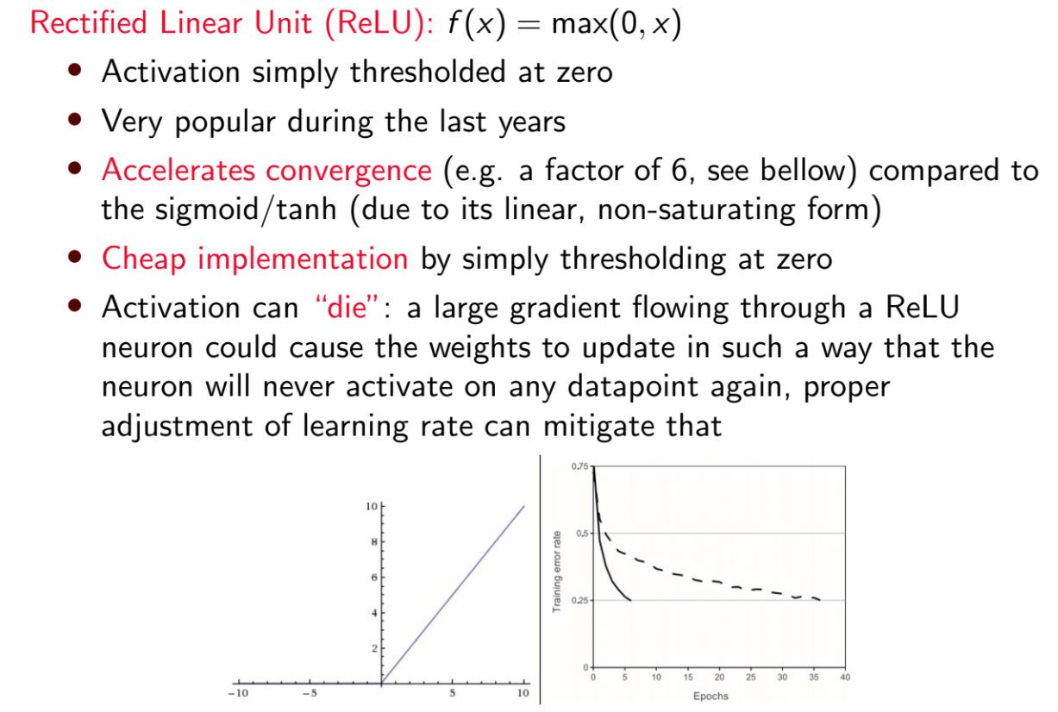
Activation Function
Notes:
Lec 26 page 39

Slide 34
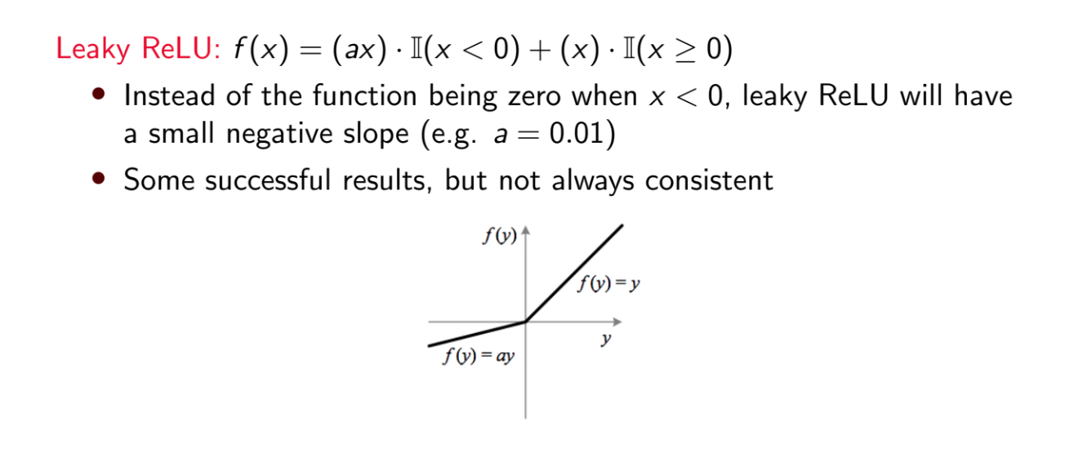
Activation Function
Notes:
Lec 26 page 40

Slide 35
Outline
Perceptron
Approximating linear functions
Activation Function
Backpropagation
Optimization
Neural Network Training and Design

Slide 36
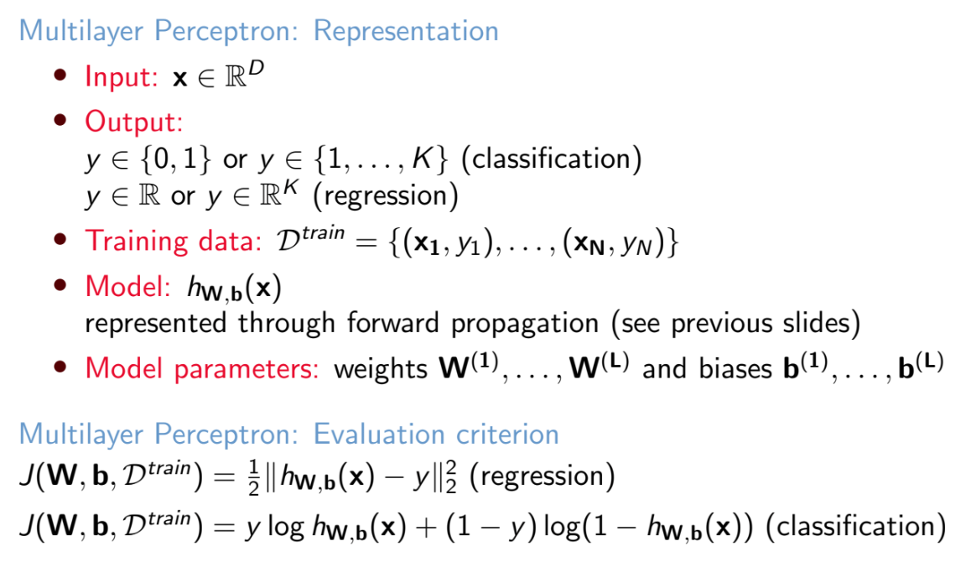
Backpropagation
Notes:
Lec 28 page 7

Slide 37
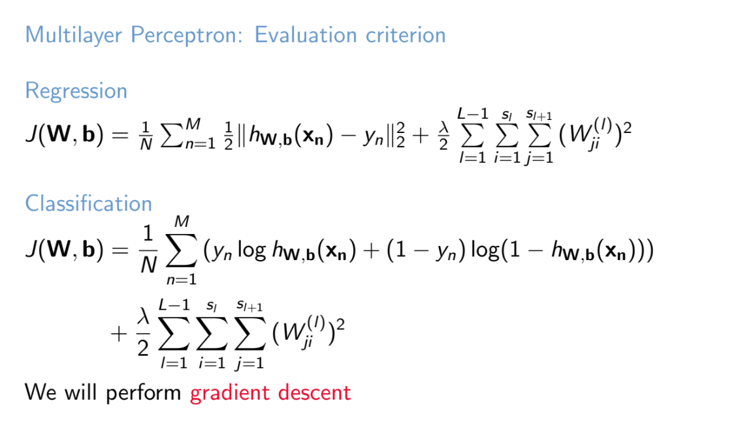
Backpropagation
Notes:
Lec 28 page 8

Slide 38
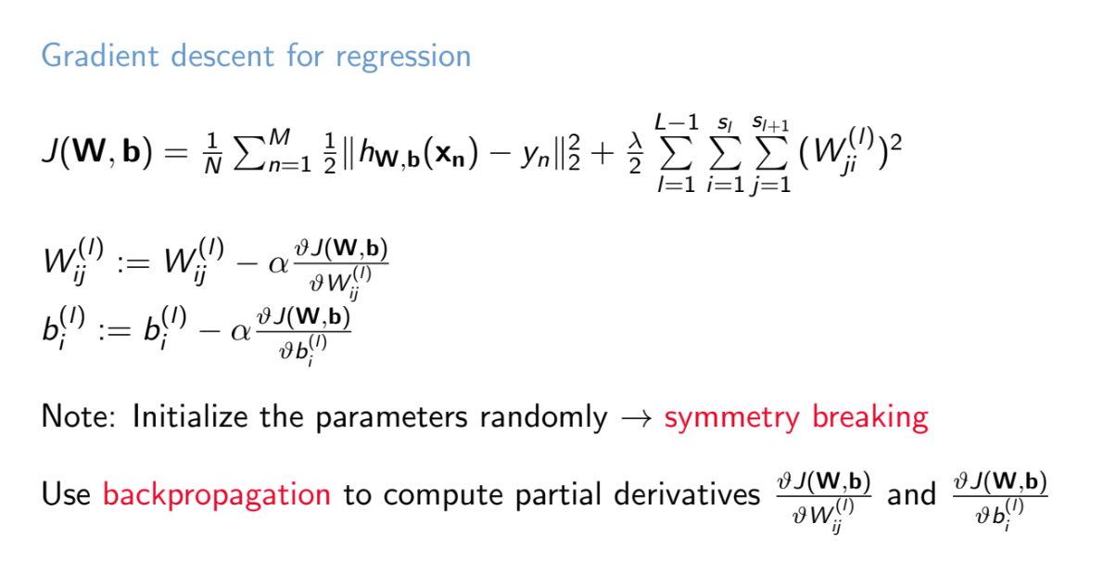
Backpropagation
Notes:
Lec 28 Page 9

Slide 39
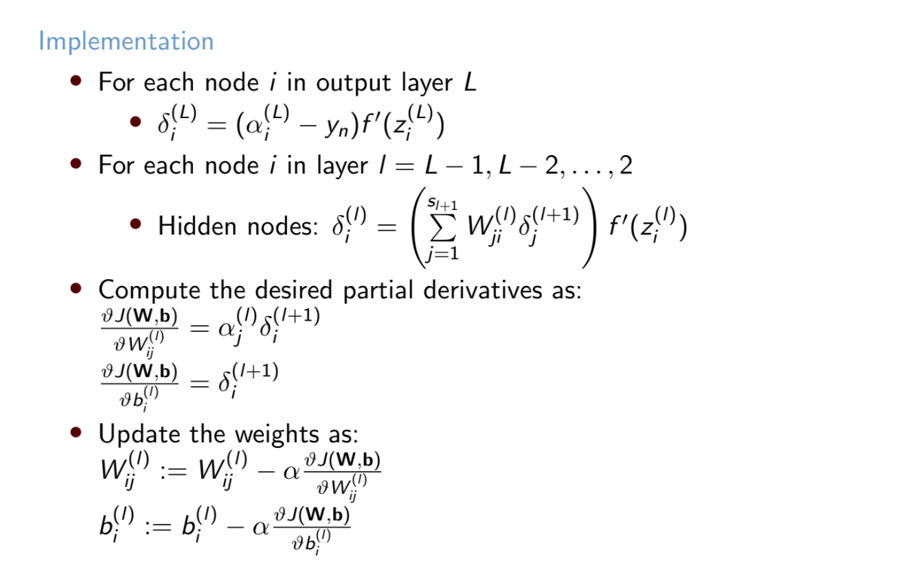
Backpropagation
Notes:
Lec 28 page 10

Slide 40
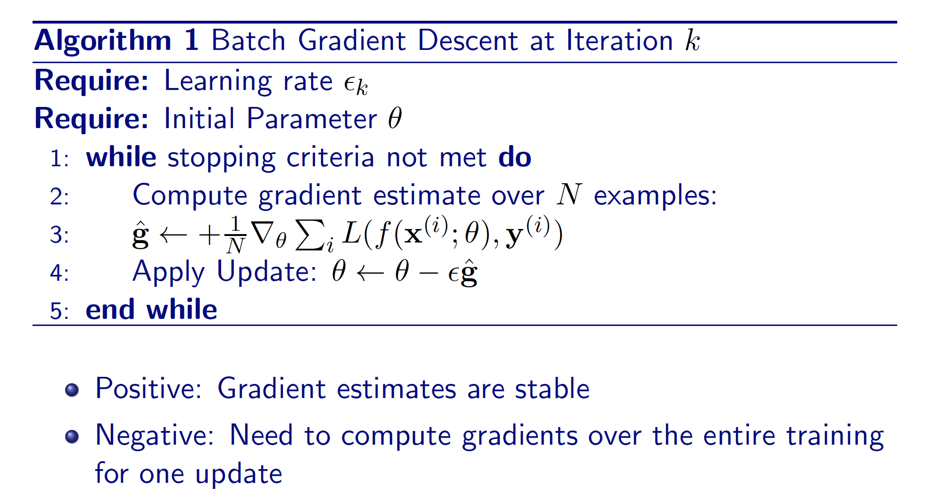
Optimization
Gradient Descent (GD)
Notes:
Atlas Lecture 15 page 2

Slide 41
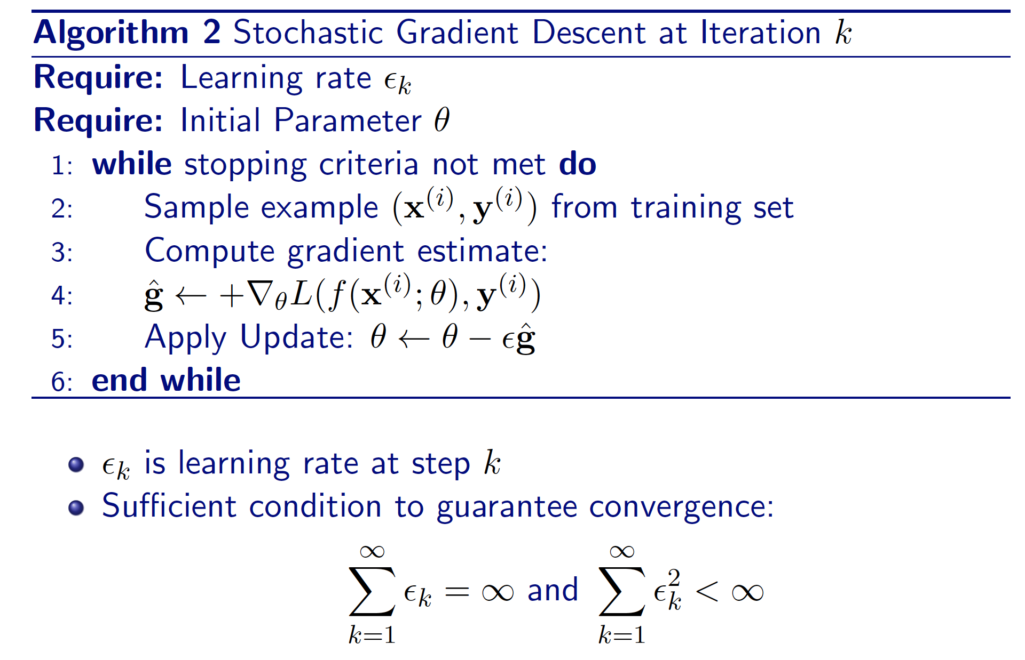
Optimization
Stochastic Gradient Descent (SGD)
Notes:
Atlas Lecture 15 page 2

Slide 42
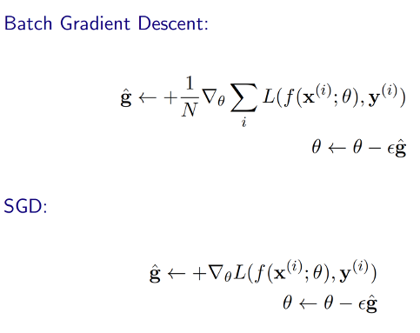
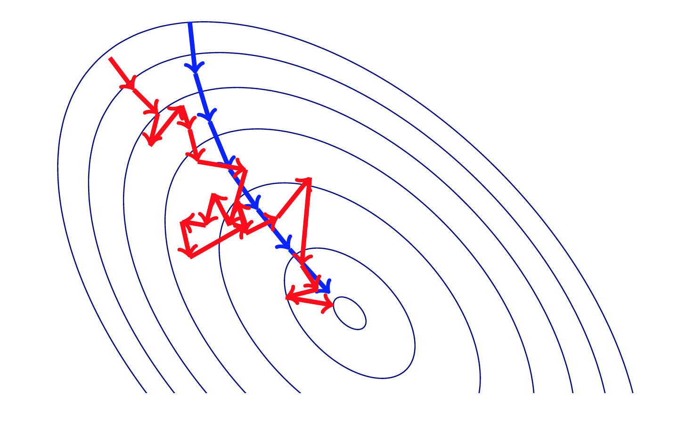
Optimization
GD versus SGD
Notes:
Atlas Lecture 15 page 2

Slide 43
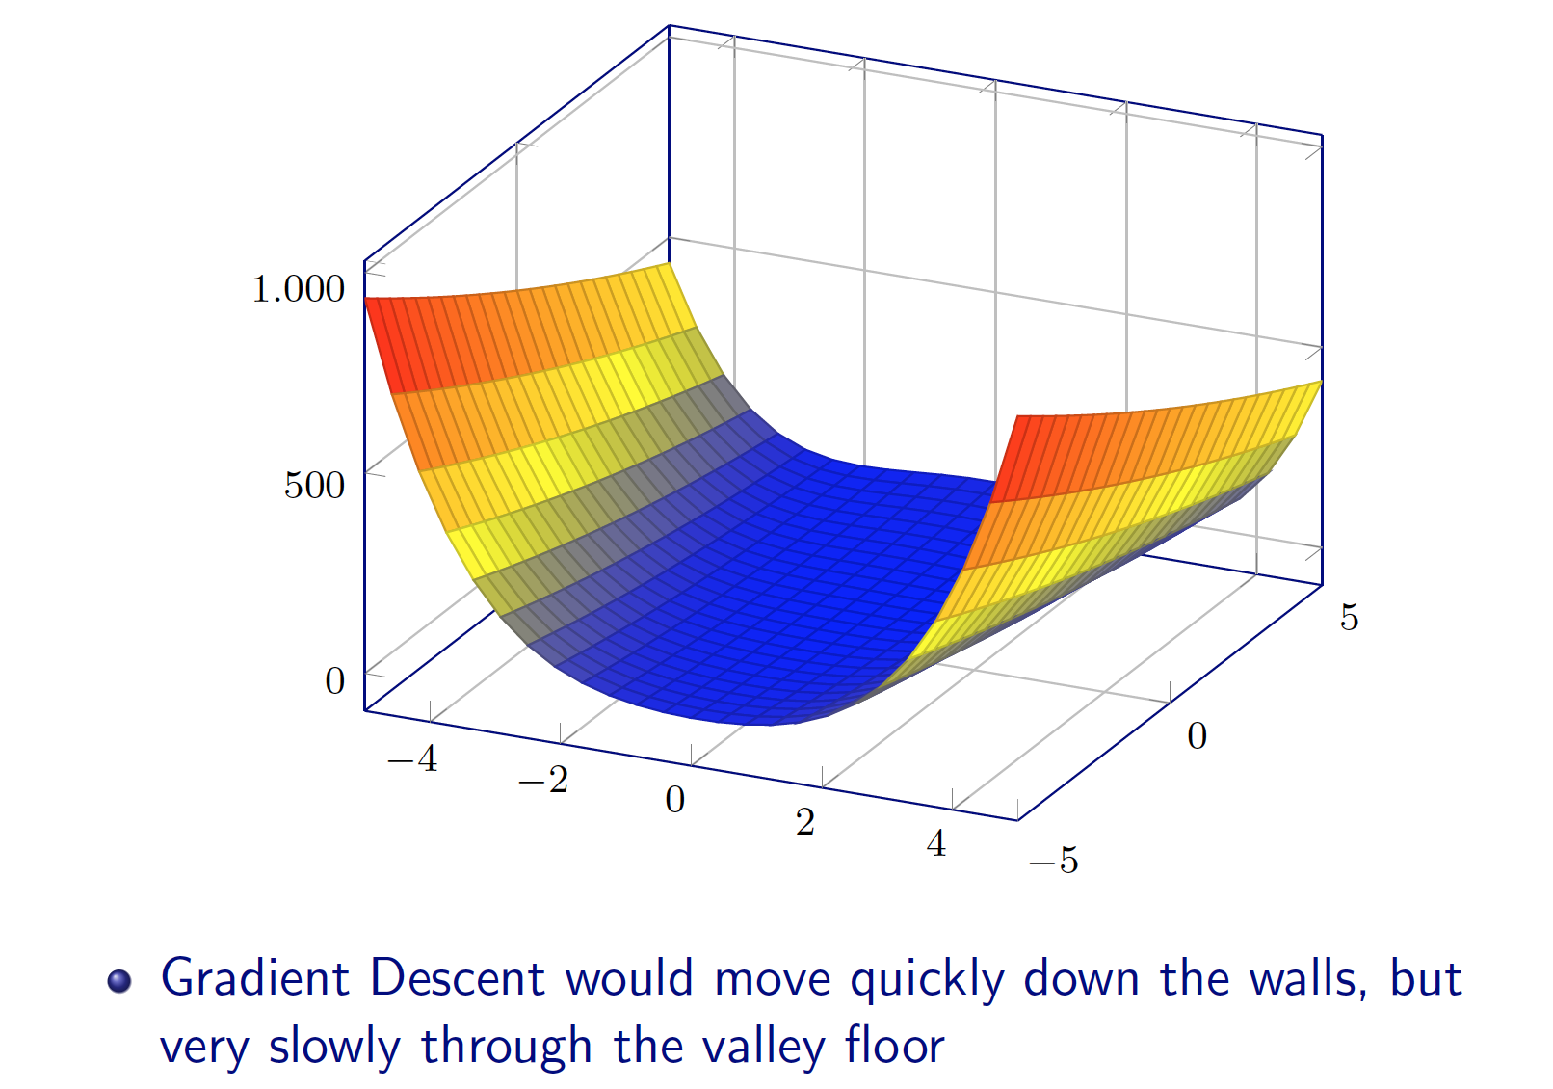
Optimization
Momentum
The Momentum method is a method to accelerate learning using SGD.
In particular SGD suffers in the following scenarios:
Error surface has high curvature
Small but consistent gradients
Noisy gradients
Notes:
Atlas Lecture 15 page 2

Slide 44
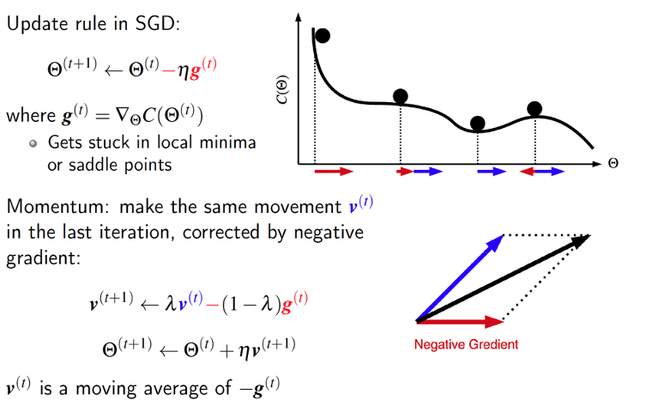
Optimization
Notes:
Atlas Lecture 15 page 2

Slide 45
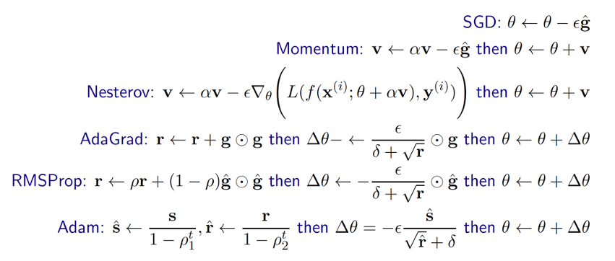
Optimization
Popular Solver Examples: AdGrad, RMSProp, Adam
Notes:
Atlas Lecture 15 page 8

Slide 46
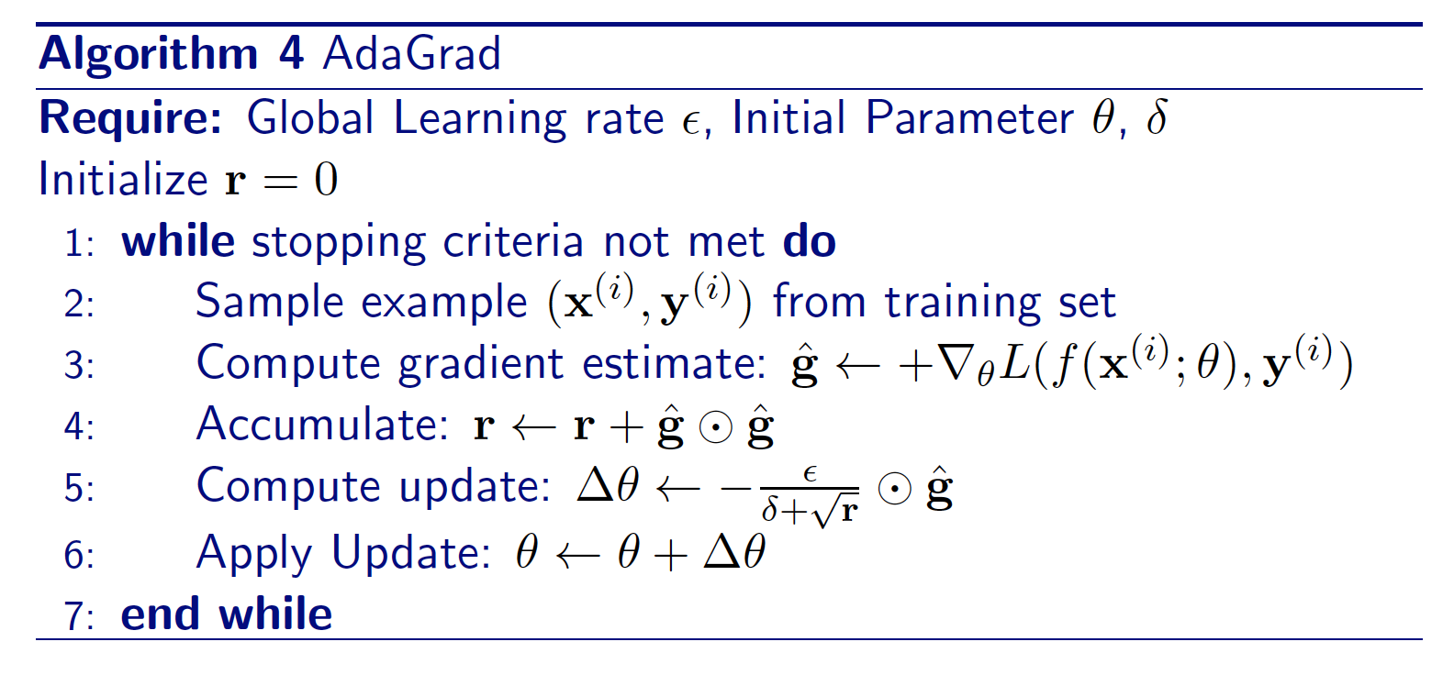
Optimization
AdaGrad
Idea: Downscale a model parameter by square-root of sum of squares of all its historical values
Parameters that have large partial derivative of the loss -> learning rates for them are rapidly declined
Some interesting theoretical properties
Notes:
Atlas Lecture 15 page 8

Slide 47
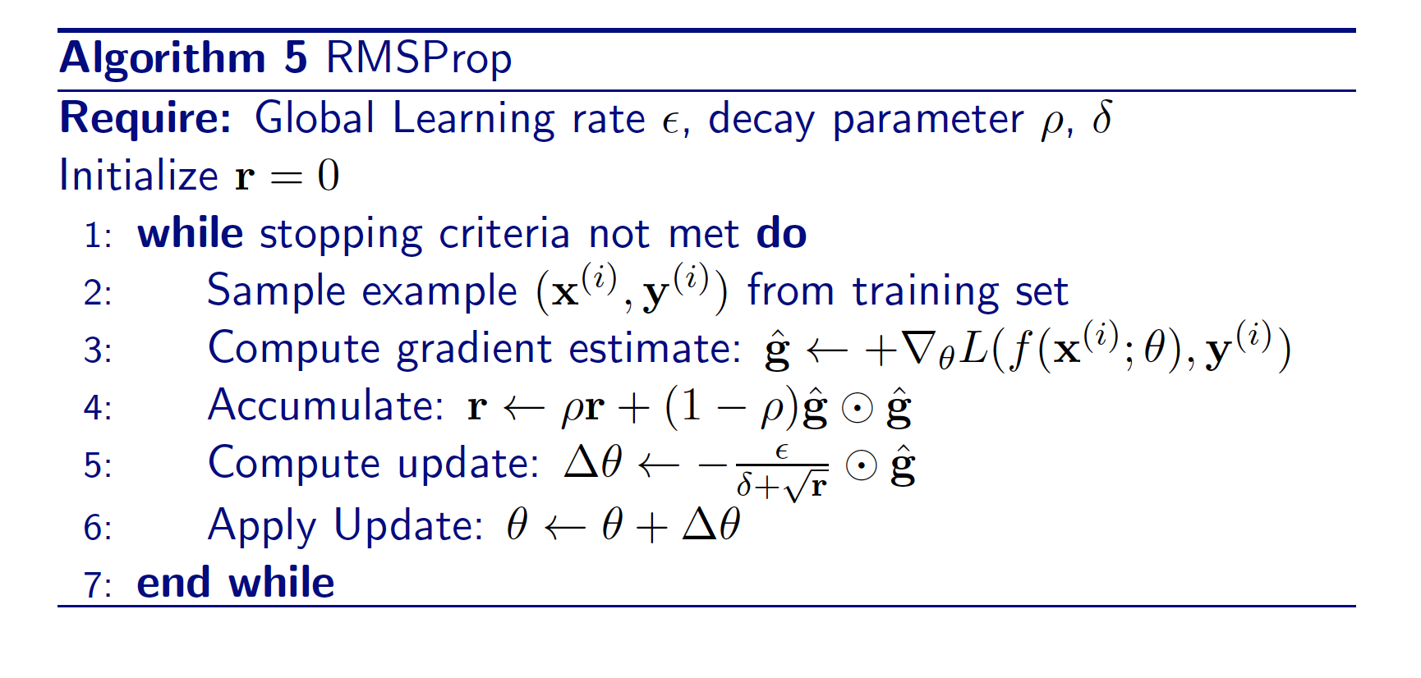
Optimization
RMSProp
AdaGrad might shrink the learning rate too aggressively, we can adapt it to perform better by accumulating an exponentially decaying average of the gradient
Notes:
Atlas Lecture 15 page 8

Slide 48
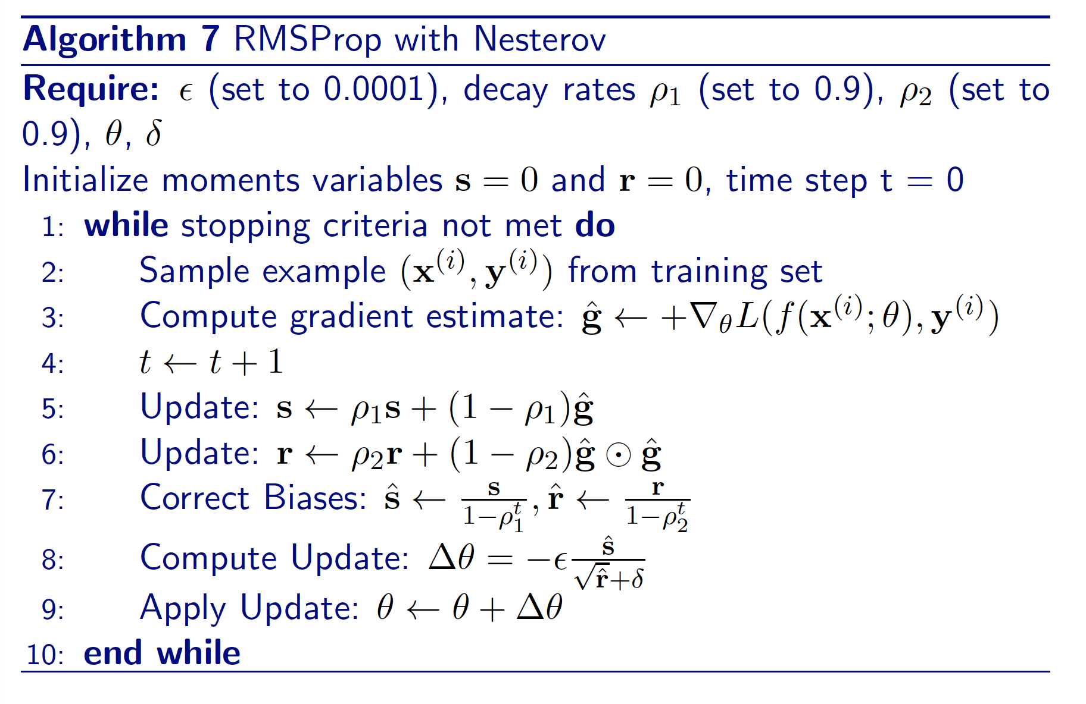
Optimization
Adam
Adam is like RMSProp with Momentum but with bias correction terms for the first and second moments
Notes:
Atlas Lecture 15 page 8

Slide 49
Outline
Perceptron
Approximating linear functions
Activation Function
Backpropagation
Optimization
Neural Network Training and Design

Slide 50
Neural Network Training
Minibatch
Potential Problem: Gradient estimates can be very noisy
Obvious Solution: Use larger mini-batches (In theory, growingly larger)
Advantage: Computation time per update does not depend on number of training examples.
This allows convergence on extremely large datasets
“Large Scale Learning with Stochastic Gradient Descent”, Leon Bottou.
Notes:
Atlas Lecture 15 page 5

Slide 51
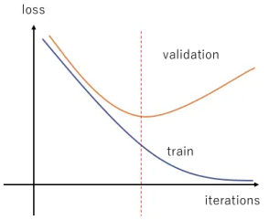
Neural Network Training
Challenge: Overfitting

Slide 52
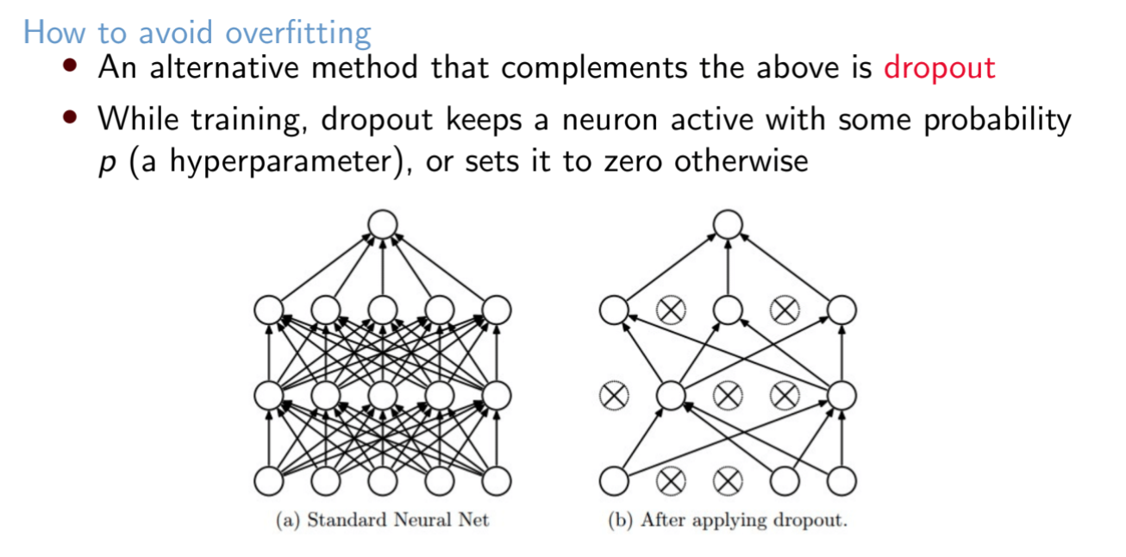
Neural Network Training
Dropout
Notes:
Lec 29 page 12

Slide 53
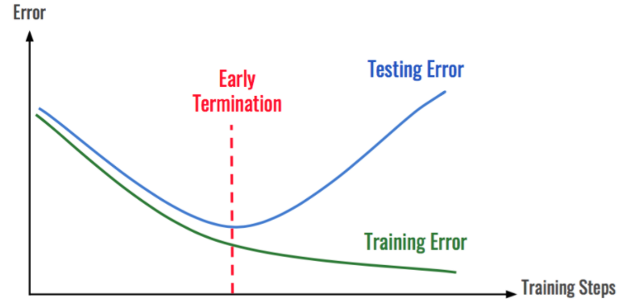
Neural Network Training
Early stop

Slide 54
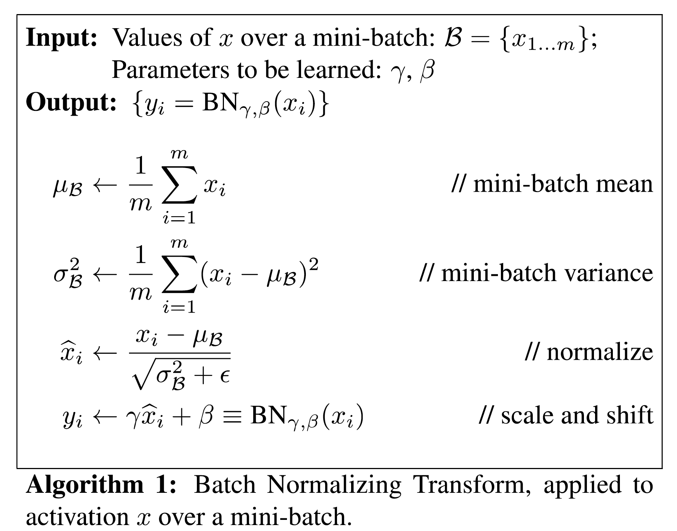
Neural Network Training
Batch Normalization
In ML, we assume future data will be drawn from same probability distribution as training data
For a hidden layer, after training, the earlier layers have new weights and hence may generate a new distribution for the next hidden layer
We want to reduce this internal covariate shift for the benefit of later layers
Notes:
Atlas Lecture 15 page 21

Slide 55
Neural Network Training
Batch Normalization
First three steps are just like standardization of input data, but with respect to only the data in mini-batch.
We can take derivative and incorporate the learning of last step parameters into backpropagation.
Note last step can completely un-do previous 3 steps
But even if so, this un-doing is driven by the later layers, not the earlier layers; later layers get to “choose” whether they want standard normal inputs or not

Slide 56
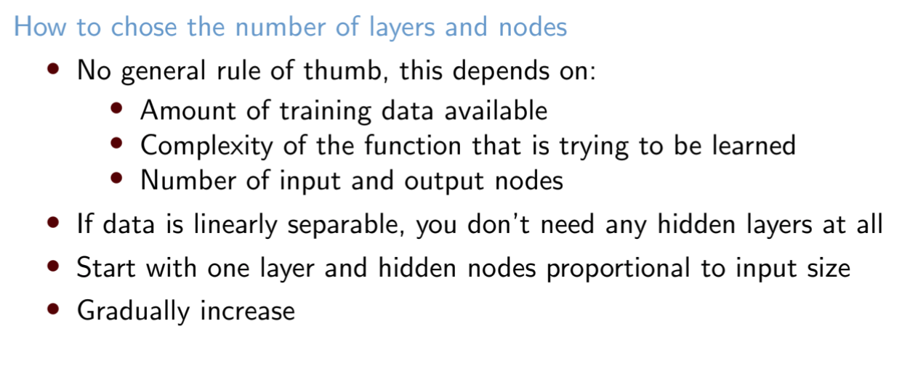
Neural Network Design
Notes:
Lec 28 page 14

Slide 57

Hyperparameter Tuning
Notes:
Lec 28 page 49

Slide 58

Challenge
Notes:
Lec 28 page 23

Slide 59

Challenge
Notes:
Lec 29 page 23

Slide 60

Unsupervised Pretraining
Notes:
Lec 29 page 24

Slide 61

Unsupervised Pretraining
Notes:
Lec 29 page 25

Slide 62


Unsupervised Pretraining
Masked Pretraining
Mask some part of the input
Get the model to predict the masked portion
Notes:
Lec 29 page 26

Slide 63

Unsupervised Pretraining
Joint-Embedding Self-Supervised Pretraining
Create two different views of an instance
Train a model to maximize the agreement between the views
Notes:
Lec 29 page 26

